Slide 1

Ancient Impacts and Zircon:
Windows to the Early Solar System Evolution
Madeline Marquardt
Advisors: Dr. Tom Sharp and Dr. Mélanie Barboni

Slide 2
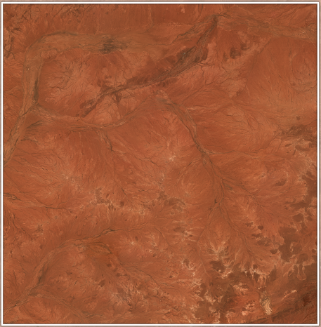
Where do we start?
Jack Hills, W. Aust.
4.375 Ga

Slide 3

Context of Everything: Time Zero
Allende includes some of the oldest material in our solar system: CAIs and Chondrules
4,567,000,000
Years old

Slide 4
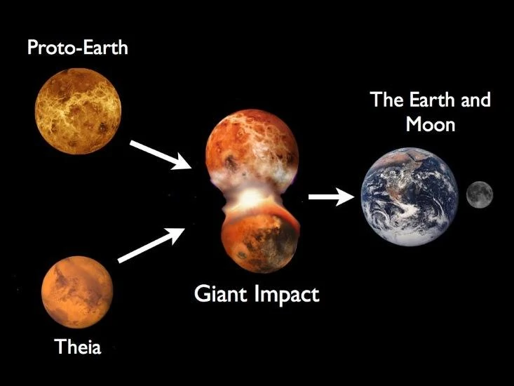
Moon Forming Impact
Differentiation of crust at 4.51 Ga

Slide 5
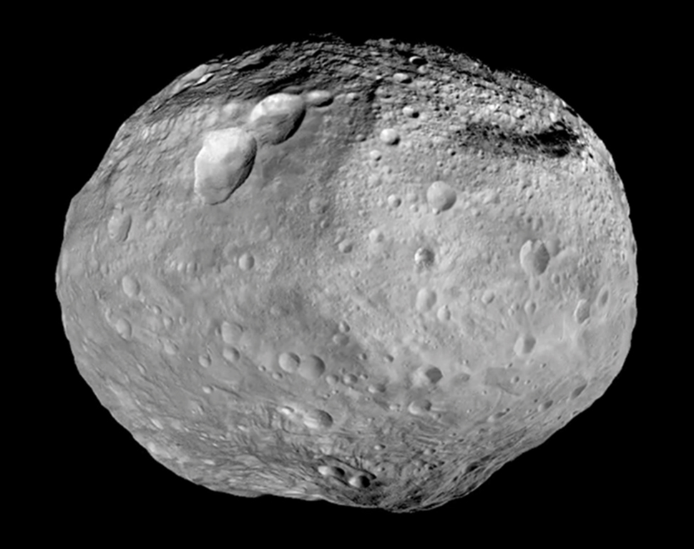
Accretion of Vesta ~0.8 Ma after CAIs (Desch et al. 2018)
Timeline of Solar System
Ureilites
0.6 Ma
Carbonaceous Chondrites
2.4-4.1 Ma
0 Ma
4.5 Ma
4 Vesta
0.8 Ma
H & LL
Chondrites
2.0-2.2 Ma
Crust
Mantle
Interior
Core

Slide 6
Meteorite(s) From Vesta

Slide 7
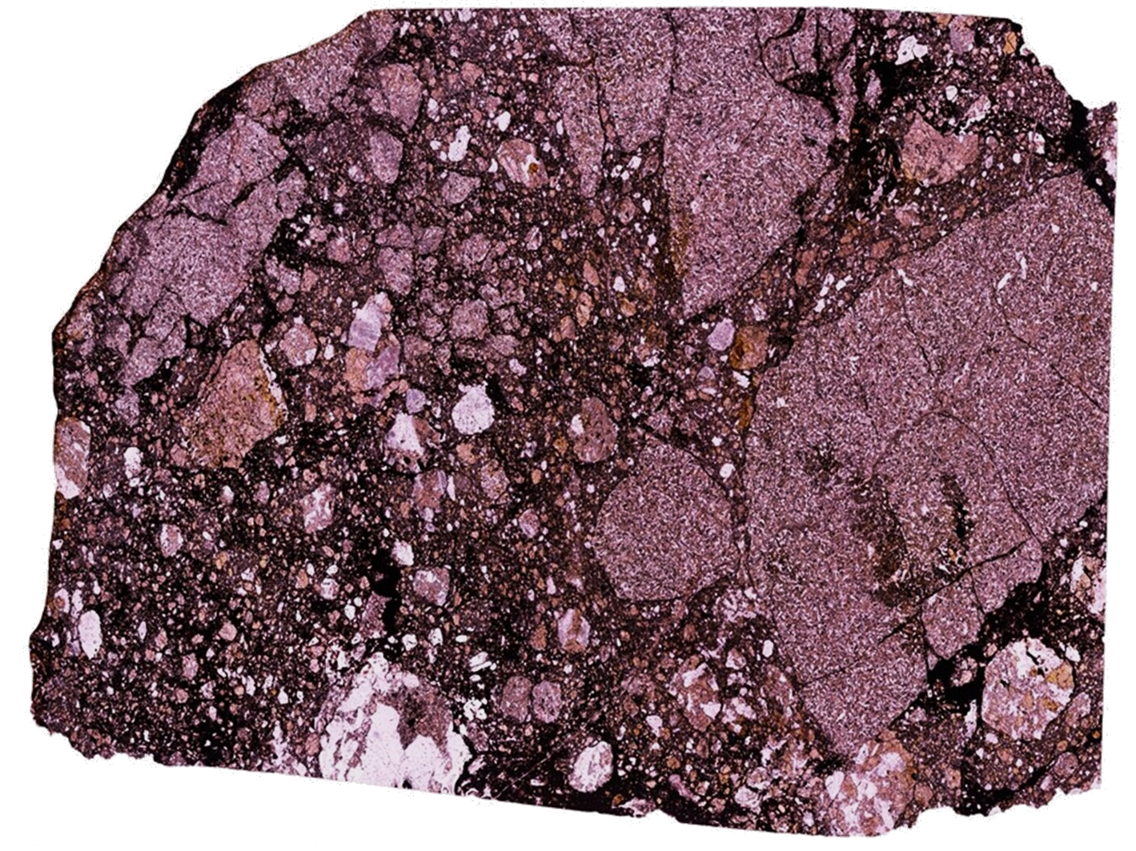
Northwest Africa (NWA) 8677
NWA 8677 Lithologies
Gabbro
Basalt
Breccia (not denoted)
2.5 mm

Slide 9
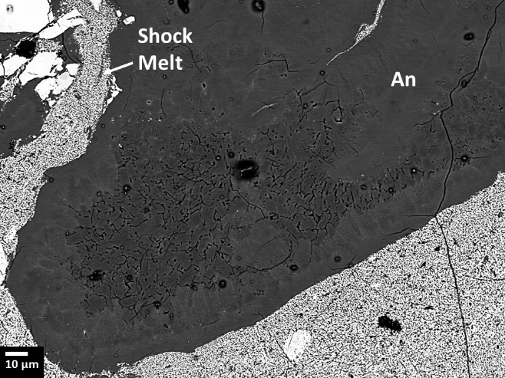
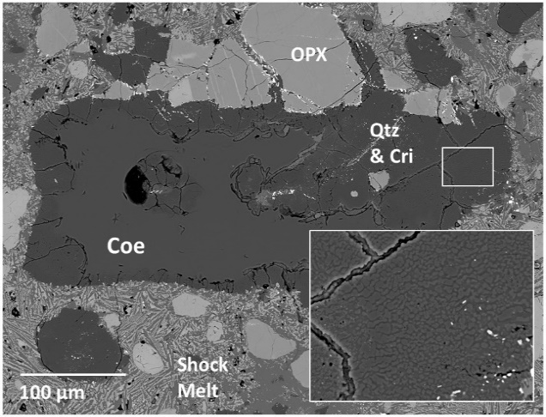
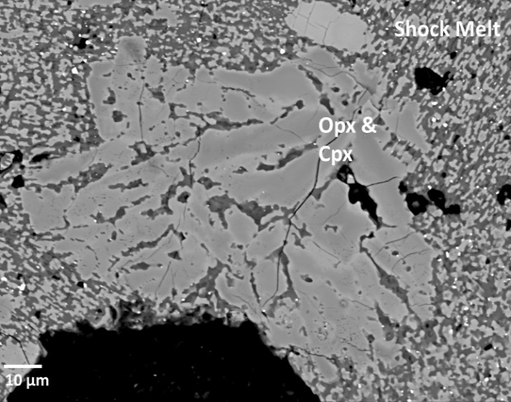
Highly Shocked Gabbro and Breccia: S4-S5
Gabbro
Basalt
Breccia
Recrystallized Anorthite (An)
Back Transformed from High-Pressure Phase
Preservation of Coesite (Coe)
High Pressure phase of Silica (Qtz)
Partial Melted Pyroxene
Diffused Grain Boundaries
Notes:
Don’t say what BSE is. Recrystallized grain of feldspar that is induced by a high temperature melting event.
High Pressure phase of quartz that serves as a record of high pressure and temperature.
Partially melted re-equilibriated tells us the temperature was very high

Slide 10
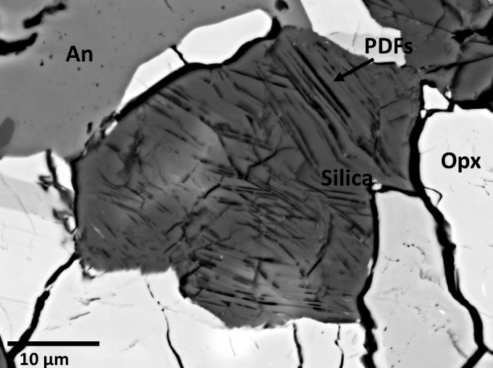
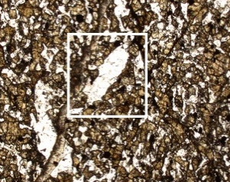
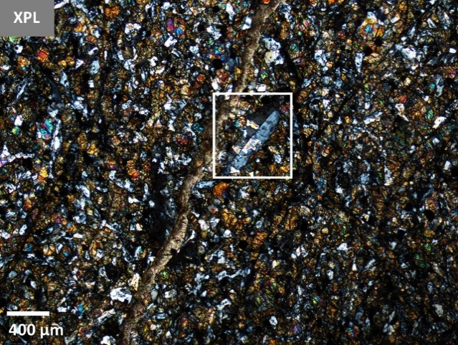
Weakly Shocked Basalt: S2-S3
Gabbro
Basalt
Breccia
PPL
XPL
Planar Deformation (Transformation) Features
Transforming to Amorphous Glass Along Planes
Crystalline Plagioclase
In XPL, Feldspar Grain Still Retains Twinning Feature
Crystalline Plagioclase

Slide 11
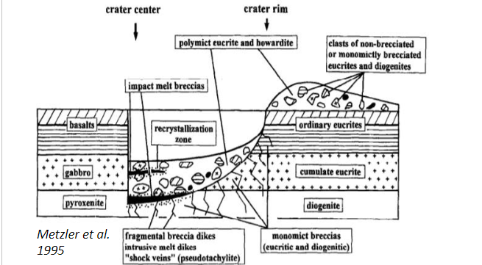
Initial Impact:
Highly Shocks and Brecciates the Gabbro
Second Impact:
Weakly Shocks the Basalt
Generates the Shock Melt
Notes:
More time. Put more geologic context into the shock stages

Slide 12
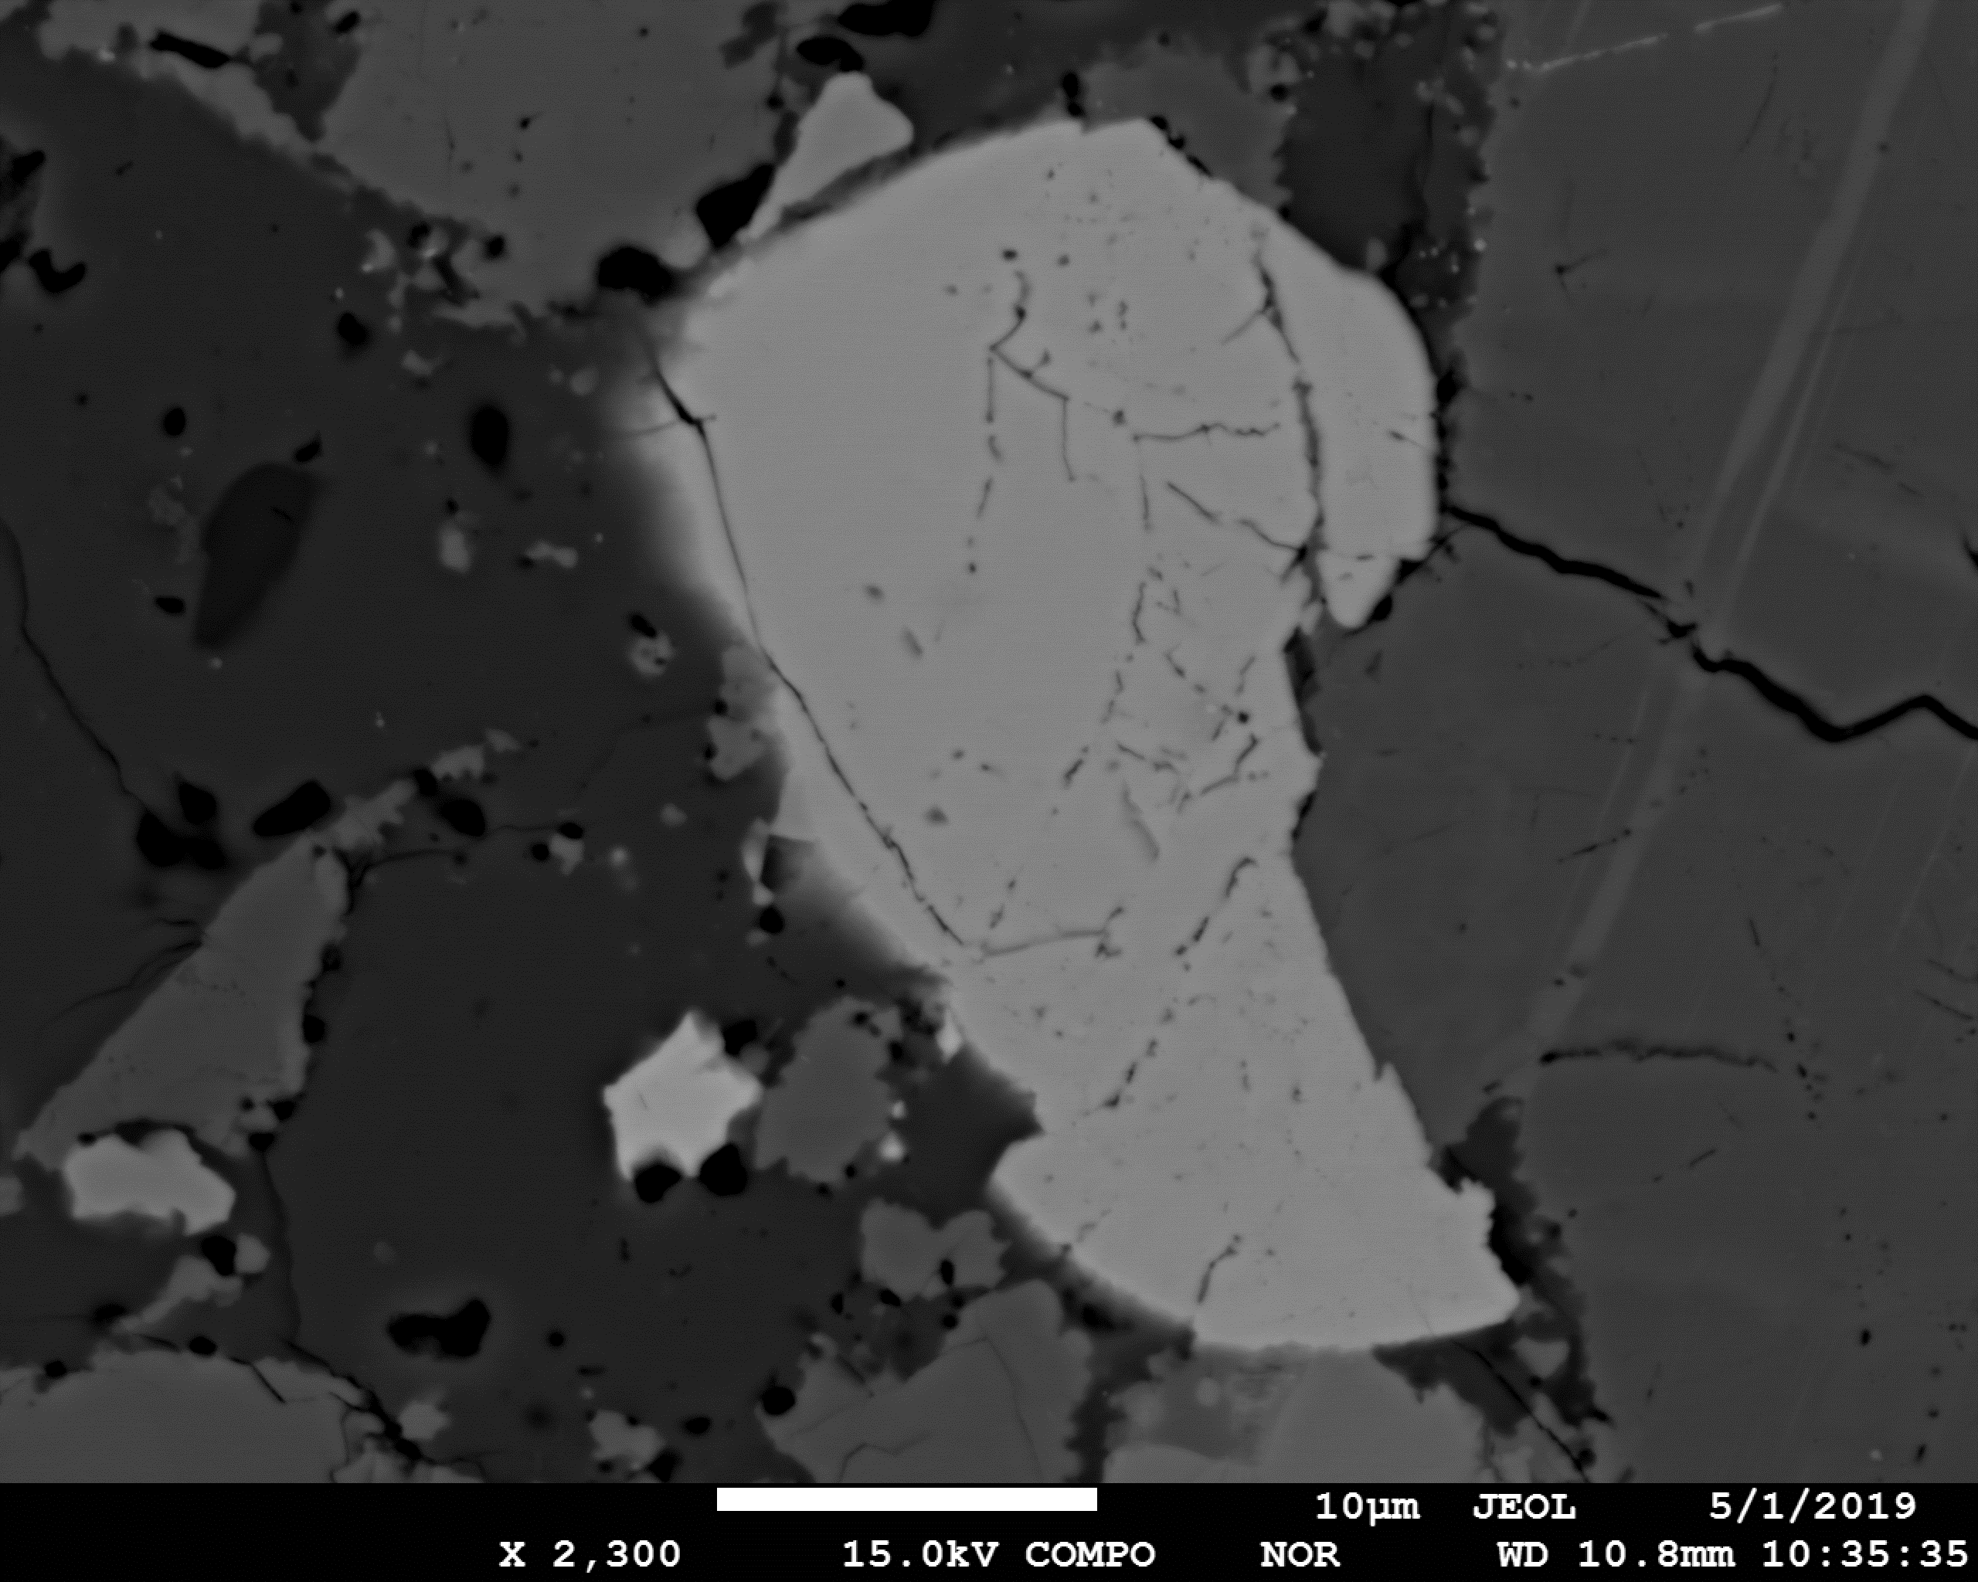
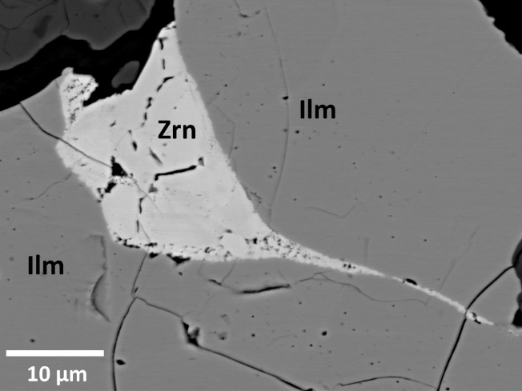
An
An
Zrn
Zrn
Cpx
Plan to tie together this conclusion…
Use Zircon!
Cpx
10 μm
10 μm
Cpx
An
Zrn
Zrn
An
1 μm
10 μm
Notes:
We know these rocked has been impacted, and now we can use zircon to give us the timing of impact

Slide 13
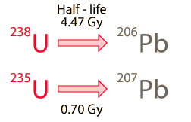
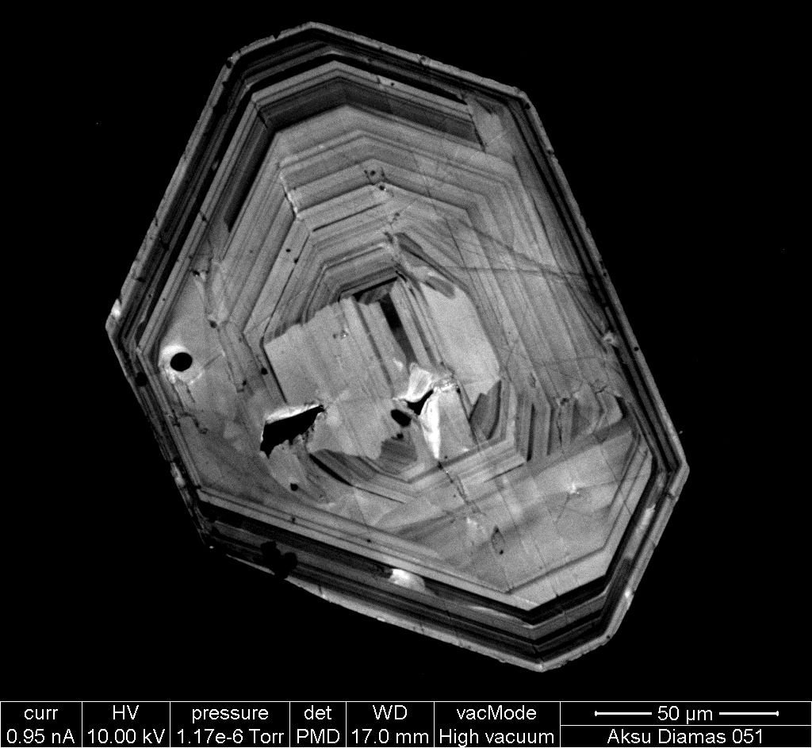
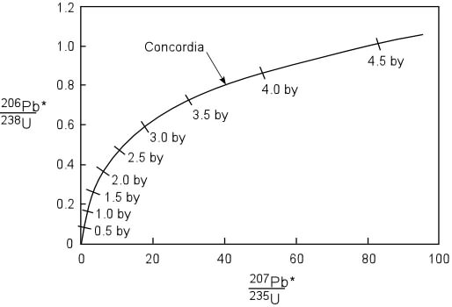
U-Pb Decay: How it Works
Scenario 1
U
Pb
U

Slide 14
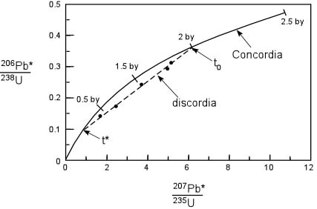
U-Pb Decay: How it Works
Scenario 2
U
Pb
Pb escapes
U
U
Notes:
If the sampke gets hot enough, the lead will escape

Slide 15
Age of Crystallization
Records time of Impact
Opx
Zrn
An
10 μm
Notes:
Explain that we will go to UCLa to get these ages.
Determine when these rocks formed and when they were impacted.

Slide 16


Acknowledgments and Thanks!

